Slide 1

https://sahibulsaif.wordpress.com/wisdom/bismillah-nature/

Slide 2
ER Modeling
CSC271 – DATABASE SYSTEMS

Slide 3
Previous Lecture Overview

Slide 4
Today’s Lecture
In this lecture, you will learn the following aspects of ER Model:
Existence Dependence
Weak / Strong Entities
Identifying relationships
Modelling Techniques
Enhanced ER Concepts

Slide 5
Existence Dependence
Existence dependency means that an instance of one entity cannot exist without the existence of some other related entity.
For example:
A Subject being offered at the University, must have the relevant Offering details associated with it, so OFFERING is existence-dependent on SUBJECT.

Slide 6
Strong vs Weak Entity
An existence-independent entity is also called strong entity.
A weak entity is an entity type that, in addition to being existence dependent, has a primary key that has been totally or partially constructed from the entity it depends on.
A weak entity is represented by a double lined rectangle.
Relationship of a weak entity (identifying relationship) is represented by double diamond.
Identifier of weak entity (Partial identifier) is dashed-underscore.

Slide 7
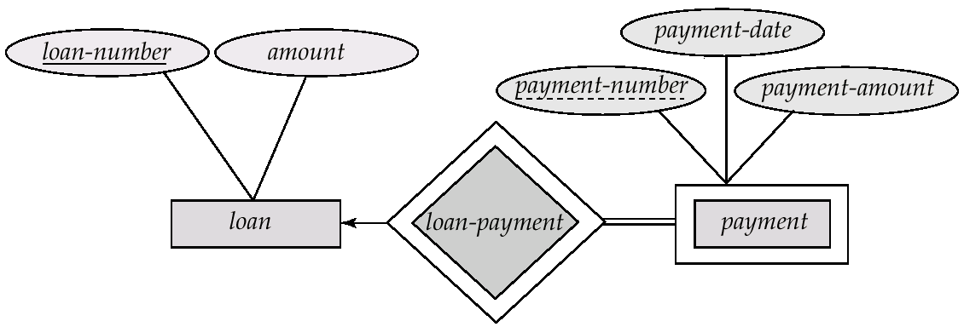
Strong vs Weak Entity

Slide 8
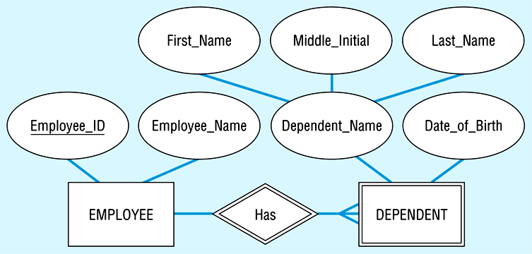

Slide 9
Modeling Techniques : Naming Conventions
The name of an entity, attribute or relationship should:
Related to business, not technical, characteristics (File 10, Bit7)
Meaningful and self-documenting
Unique (Home Address versus Campus Address)
Readable
Composed of words from an approved list (maximum vs upper limit, ceiling, or highest)
Repeatable

Slide 10
Modeling Techniques: Relationship or Associative Entity
Make associative entity if:
All the relationships for the participating entity types are “many” relationships.
The resulting associative entity type has independent meaning to end users and, preferably, can be identified with a single-attribute identifier.
The associative entity has one or more attributes in addition to the identifier.

Slide 11
Modeling Techniques: Relationship or Associative Entity

Slide 12
Modeling Techniques: Relationship or Associative Entity

Slide 13
Modeling Techniques: Attribute or Entity

Slide 14
Enhanced ER Concepts
The ER model concepts are sufficient for representing many database schemas for traditional database applications.
Designers of database applications have tried to design more accurate database schemas that reflect the data properties and constrains more precisely
Features that have been proposed show how the ER model can be enhanced to include these concepts.

Slide 15
Enhanced ER Concepts
In many cases an entity type has numerous subgroupings of its entities that are meaningful and need to be represented explicitly because of their significance to the database application.
For example: EMPLOYEE may be further grouped into:
SALARIED_EMPLOYEE, HOURLY_EMPLOYEE
Based on the EMPLOYEE’s method of pay

Slide 16
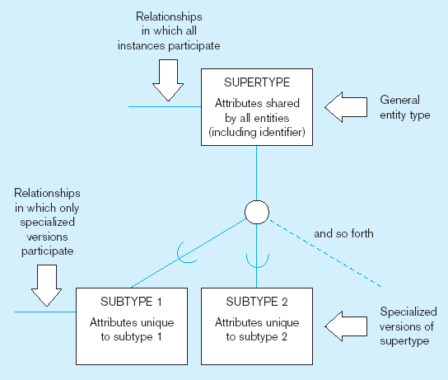
Enhanced ER Concepts
Subtype: A subgrouping of the entities in an entity type that has attributes distinct from those in other subgroupings
Supertype: A generic entity type that has a relationship with one or more subtypes

Slide 17
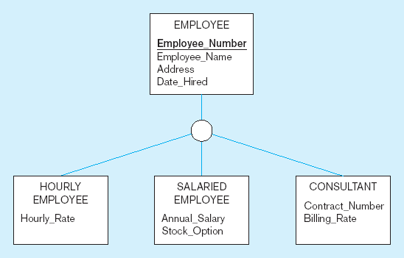
All employee subtypes will have emp nbr, name, address, and date-hired
Each employee subtype will also have its own attributes

Slide 18
Enhanced ER Concepts : Inheritance
Inheritance dictates that an entity that is member of a subclass inherits
All attributes of the entity as a member of the superclass
All relationships of the entity as a member of the superclass
Relationships at the Supertype level indicate that all subtypes will participate in the relationship
The instances of a subtype may participate in a relationship unique to that subtype. In this situation, the relationship is shown at the subtype level

Slide 19
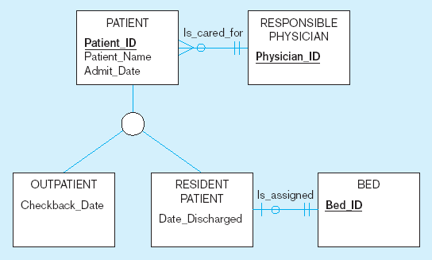
Both outpatients and resident patients are cared for by a responsible physician
Only resident patients are assigned to a bed

